Slide 1
The Policy of Sustainable Protection and Management for Primary Natural Forest and Peat Ecosystem in order to Refining Forestry Governance in Indonesia
Ida Nurlinda
Faculty of Law
Universitas Padjadjaran
2015

Slide 2
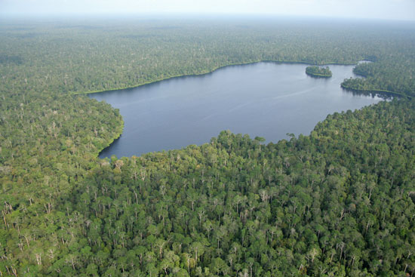
Peatlands in Indonesia
Peatlands in Indonesia estimated 20.6 million ha/10.8 % of Indonesia's land area
From that area approximately 7.2 million ha or 35% of them are on the island of Sumatra; largely used for plantation area

Slide 3
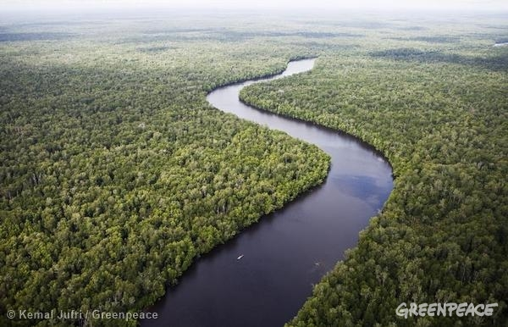
Primary Natural Forest in Indonesia
Indonesia has 93.6 million ha of primary forest, the second widest after Bax
According to the National Forestry Plan year period 2011-2030: approximately 28.39 million ha/21.7% natural forests and peatlands deserve protection and in critical condition

Slide 4
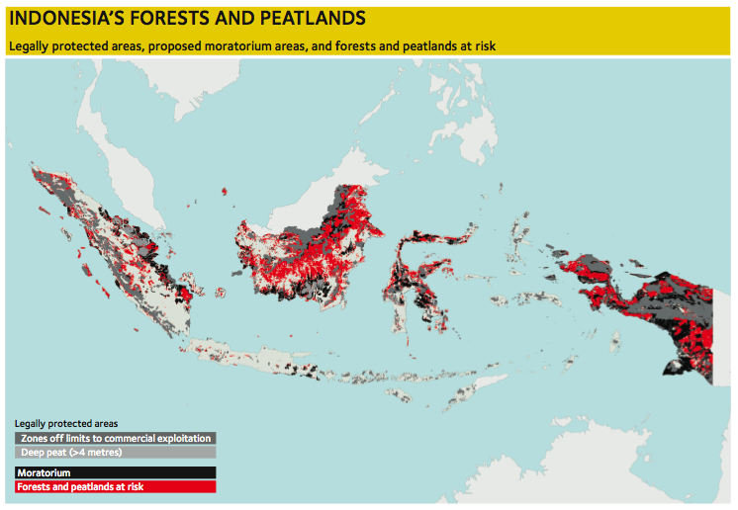
ANDROID PROJECT
Show and explain your web, app or software projects using these gadget templates.

Slide 5
Indonesian Government’s efforts in Tackling the Destruction of Forests and Peatlands
Moratorium on Licensing and Utilization of Primary Natural Forests and Peatlands Policies

Slide 6
Moratorium on Licensing and Utilization of Primary Natural Forests and Peatlands Policies
Presidential Instruction Number 10 of 2011
Presidential Instruction Number 6 of 2013
Presidential Instruction Number 8 of 2015

Slide 7
Moratorium Policy is not Effective
Legal form of a moratorium policy only the president's instructions, so that not have a good binding force
Moratorium is intended for forest conservation and forest protection, which already protected by law; so that if the law enforced, the moratorium not needed
Excepted moratorium on the construction of geothermal, oil and gas, electricity, land for rice and sugar cane; also excepted for the applicant who has obtained a permit in principle, and the application for renewal of forest utilization license; also excepted for ecosystem restoration

Slide 8
Indonesian Policy forward in Tackling the Destruction of Forests and Peatlands
The minimum legal form of policies should be a presidential regulation so as to to have a good binding force
Excepted moratorium on the construction of geothermal, oil and gas, electricity, land for rice and sugar cane; the applicant who has obtained a permit in principle, and the application for renewal of forest utilization license are contrary to the policy of emission reduction
Moratorium ought not only to primary forests but also to secondary forests which covers more than half the forest area of Indonesia. Secondary forests also have a carbon stocks and biodiversity of higher

Slide 9
Moratorium on licensing policy is not a goal, but one of a tool to achieve forest good governance

Slide 10
thank you

